Slide 1
I501 - INTRODUCTION TO INFORMATICS
FINAL PROJECT
GROUP 7
STUDYING ACCESS TO HEALTHCARE PATTERNS USING MEDICARE HEALTH INSURANCE​
IUPUI
Professor - Dr. Saptarshi Purkayastha
Group 7 – Nicole Rachel Koshy
Mothi Gowtham Ashok Kumar
Prudhvi Raj Terli
Santosh Bokka
​Sony Priya Surapaneni
Vineela Deepthi Oguri
Divya Gottimukkula

Slide 2
CONTENTS
Introduction
Aim & Objective
Purpose
Methodology
Datasets
List of Tables
Data Cleaning, Extraction
Exploratory Data Analysis
Clustering & Principal Component Analysis for Visualization
Results

Slide 3
INTRODUCTION
Medicare is a federally funded Health Insurance program for US citizens, over 65 years of age and younger individuals with disabilities ¹.
Almost all Medicare participants remain enrolled in the program until they pass away.
The Centers for Medicare & Medicaid Services (CMS) collects data on these programs that can be used to analysis various healthcare patterns.

Slide 4
AIM & OBJECTIVE
Analyze availability and utilization of Medicare related healthcare services at various levels using Inpatient, Outpatient and Post-Acute care and Hospice datasets from CMS.
Assess differences in access to care at Geographic levels and based on Ethnicity
Assess differences in cost of inpatient and outpatient services
Our main objective is to determine if a difference exists in the services available through Post-acute care and Hospice services across the US
We will use certain common characteristics such as Medicare amounts, duration of care provided, difference in access based on gender, race and chronic conditions to determine if there is a difference in services available

Slide 5
RESEARCH HYPOTHESIS
Null Hypothesis:
There is no difference in access to care by patients based on geography, ethnicity, gender and chronic conditions.
There is no difference in Post-Acute care and Hospice services of different types offered to patients across the US.
Alternative Hypothesis:
There is a discernible difference in access to care by patients based on geography, ethnicity, gender and chronic conditions.
There is a discernible difference in Post-Acute care and Hospice services of different types offered to patients across the US.

Slide 6
TYPES OF POST-ACUTE CARE & HOSPICE FACILITIES
Skilled Nursing Facility(SNF)
An in-patient treatment and rehabilitation facility with trained medical professionals that include licensed nurses, physical and occupational therapists among others ².
Home Health Care (HH)
Health care services that can be provided at a patient's home for an illness or injury ^{3.}
Hospice care (HOS)
Services that focus on end-of-life care which can be provided at home or in facilities that provide care, comfort and quality of life to terminal patients ⁴.

Slide 7
TYPES OF POST-ACUTE CARE & HOSPICE FACILITIES
Inpatient Rehabilitation Facility (IRF)
Independent rehabilitation centers in acute care hospitals for patients that require round the clock nursing care ⁵.
Long Term Care (LTC) Facility
Facilities that provide various types of services required for patients who are unable to live independently ⁶.

Slide 8
HCC Scoring
HCC coding is a risk-adjustment approach that was initially created to project patients' future medical expenses. As the healthcare sector transitions to value-based payment models, the Centers for Medicare & Medicaid Services (CMS) HCC model, which was introduced in 2004, is growing in popularity.
HCC coding makes use of ICD-10-CM coding to provide risk ratings to patients. An ICD-10-CM code is issued to each HCC. Insurance companies give patients a risk adjustment factor (RAF) score based on HCC coding as well as demographic information like age and gender. Based on a patient's RAF score, insurance companies can utilize algorithms to anticipate expenses. For instance, typical medical costs for a patient over a specific time frame can be anticipated for someone with few major health concerns. On the other side, a patient with several chronic illnesses is likely to need healthcare services more frequently and incur higher expenditures.
Reference: Hierarchical condition category coding. AAFP. (2020, January 9). Retrieved December 2, 2022, from Reference Link

Slide 9
METHODOLOGY

Slide 10
DATASETS
Inpatient Services:
https://data.cms.gov/provider-summary-by-type-of-service/medicare-inpatient-hospitals/medicare-inpatient-hospitals-by-provider-and-service
Outpatient Services:
https://data.cms.gov/provider-summary-by-type-of-service/medicare-outpatient-hospitals/medicare-outpatient-hospitals-by-provider-and-service
Hospice:
https://data.cms.gov/provider-summary-by-type-of-service/medicare-post-acute-care-and-hospice-by-geography-provider
Census Data:
https://www.census.gov/data/tables/time-series/demo/popest/2020s-total-cities-and-towns.html#ds

Slide 11
DATASETS
TYPE OF DATA ​ | YEAR​ | COLUMNS ​ | ROWS​
Inpatient- Service provider​ | 2018​ | 15​ | 191303 ​
 | 2019​ | 15​ | 185498​
 | 2020​ | 15​ | 326826​
Outpatient-Service provider​ | 2018​ | 18​ | 110265​
 | 2019​ | 18​ | 112800​
 | 2020​ | 18​ | 113288​
PAC and Hospice by Geography and Provider​ | 2020​ | 139​ | 29636​

Slide 12
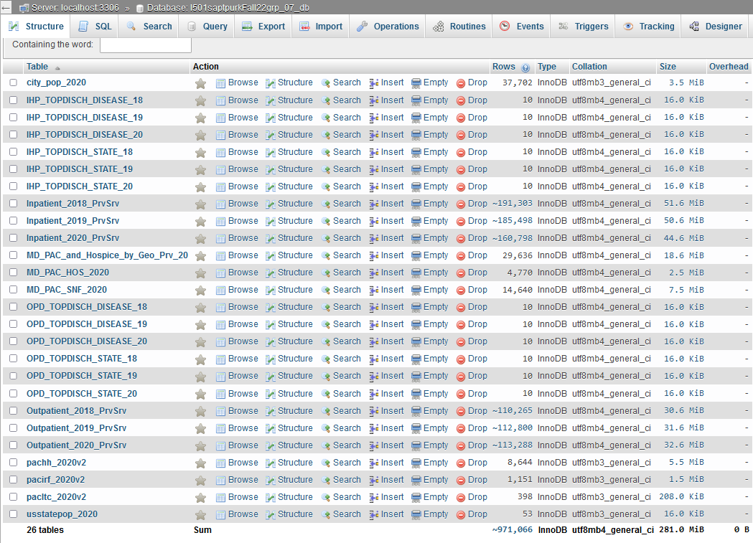
LIST OF TABLES

Slide 13
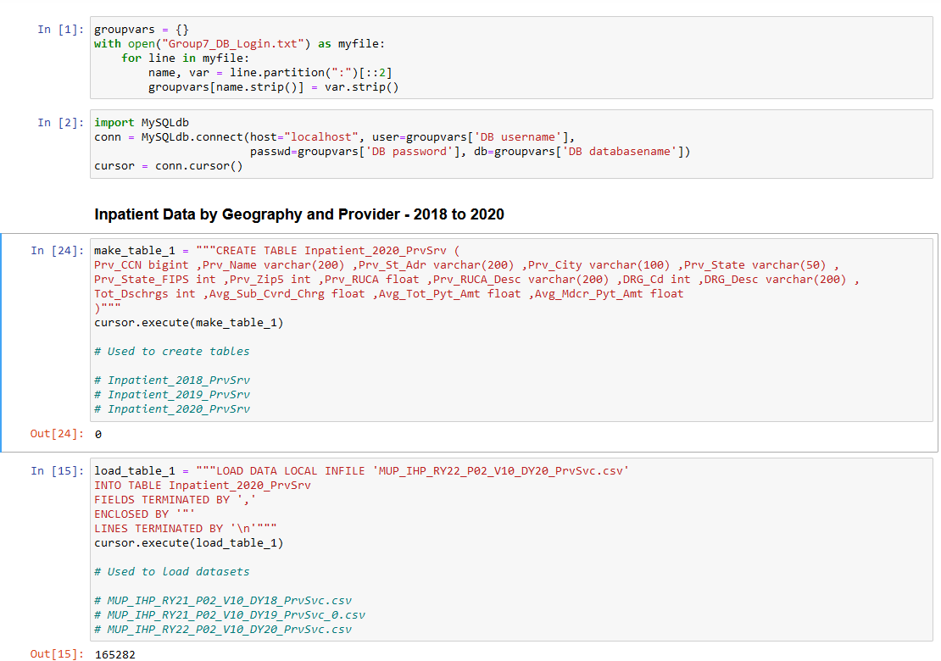
TABLE CREATION IN PYTHON
Establishing Connection to MariaDB Server
Empty Table Creation
Loading Data file into Table
Additional Table scripts in Appendix

Slide 14
TABLES LOADED DIRECTLY INTO MARIA DB
pachh_2020v2 - Home Health Facility 2020 Data
pacirf_2020v2 - Inpatient Rehab Facility 2020 Data
pacltc_2020v2 - Long Term Care Facility 2020 Data
usstatepop_2020 - US State Population Data
city_pop_2020 - City Population Data
Additional Table scripts in Appendix

Slide 15
TABLE CREATION IN MARIADB
CREATE TABLE IHP_TOPDISCH_DISEASE_18 AS (SELECT A.DRG_CD, A.DRG_DESC, SUM(A.TOT_DSCHRGS) AS TOT_DSCH_18 FROM Inpatient_2018_PrvSrv A
WHERE A.DRG_CD IN (871,291,470,177,193,872,189,378,392,690)
GROUP BY A.DRG_CD, A.DRG_DESC ORDER BY SUM(A.TOT_DSCHRGS) DESC);
CREATE TABLE IHP_TOPDISCH_STATE_18 AS (SELECT A.Prv_State, SUM(A.TOT_DSCHRGS) AS TOT_DSCH_18
FROM Inpatient_2018_PrvSrv A WHERE A.Prv_State IN ('FL','CA','TX','NY','IL','PA','OH','NC','MI','MA')
GROUP BY A.Prv_State ORDER BY SUM(A.TOT_DSCHRGS) DESC);
CREATE TABLE OPD_TOPDISCH_DISEASE_18 AS SELECT A.APC_Cd, A.APC_Desc, SUM(A.Bene_Cnt) AS TOT_DSCH_18
FROM Outpatient_2018_PrvSrv A WHERE A.APC_Cd IN (8011,5072,5191,5115,5491,5114,5302,5361,5193,5373)
GROUP BY A.APC_Cd, A.APC_Desc ORDER BY SUM(A.Bene_Cnt) DESC
CREATE TABLE OPD_TOPDISCH_STATE_18 AS SELECT A.Prv_State, SUM(A.Bene_Cnt) AS TOT_DSCH_18
FROM Outpatient_2018_PrvSrv A WHERE A.Prv_State IN ('CA','TX','FL','NY','IL','OH','PA','NC','MI','VA')
GROUP BY A.Prv_State ORDER BY SUM(A.Bene_Cnt) DESC
Additional Table scripts in Appendix

Slide 16
DATA CLEANING & EXTRACTION
THE FOLLOWING TABLES WERE CREATED FROM THE MD_PAC_and_HOSPICE_Geo_Prv_20 by selecting columns relevant to each type of facility using the associated data dictionary:
pachh_2020v2 - Home Health Facility 2020 Data
pacirf_2020v2 - Inpatient Rehab Facility 2020 Data
pacltc_2020v2 - Long Term Care Facility 2020 Data
4. MD_PAC_SNF_2020
5. MD_PAC_HOS_2020
To clean these tables the following rules were applied to all applicable columns.
Suppressed Data was replaced as follows:
* - Replaced with 0.0 (These represents counts of lower than 10)
** - Replaced with 0.8755 (These represents counts where more than 75% of the counts are associated with a single chronic condition for a provider)
CLEANING SCRIPTS (applicable to all above tables with column names ending with '_PCT'
update TABLE_NAME
set COLUMN_NAME = '0' where COLUMN_NAME = '*'
update TABLE_NAME
set COLUMN_NAME= '0.8755' where COLUMN_NAME = '**'

Slide 17
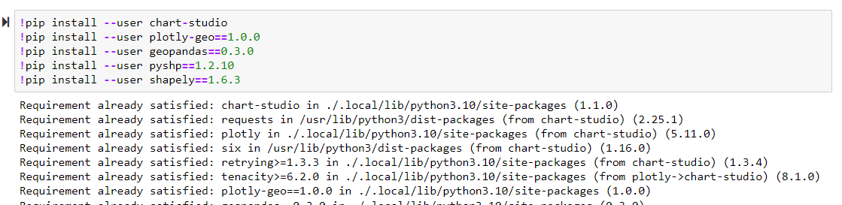
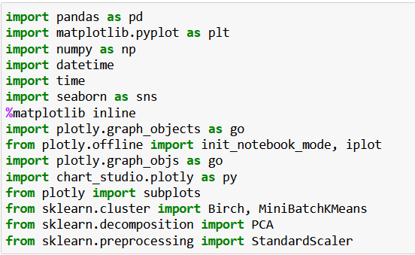
INSTALLING PACKAGES
MODULES USED

Slide 18
DATA ANALYSIS:
We have Visualized the data patterns using-
Quantitative and Qualitative analysis
Performance analysis (NumPy, pandas, Matplotlib, Seaborn, and sci-kit learn).
Explanatory data analysis (Histograms, scatterplots on in-patient and outpatient datasets)
Clustering methods (For grouping hospital facilities into distinct clusters).

Slide 19

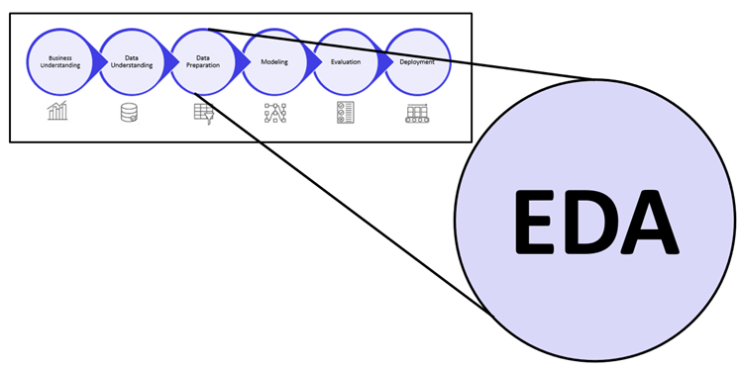
EXPLORATORY DATA ANALYSIS

Slide 20
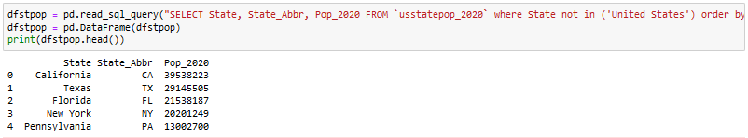
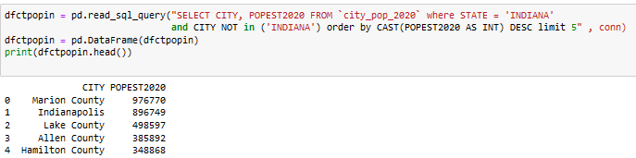
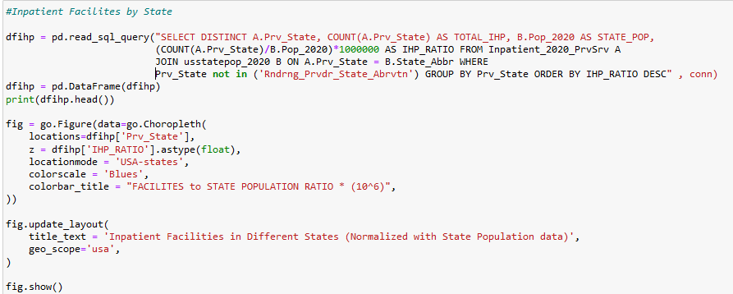
DISTRIBUTION OF FACILITIES IN DIFFERENT STATES AND INDIANA CITIES
INPATIENT & OUTPATIENT FACILITIES
States and Indiana Cities with Highest Population Numbers
Code for Inpatient Facilities
Remaining codes in Appendix​

Slide 21
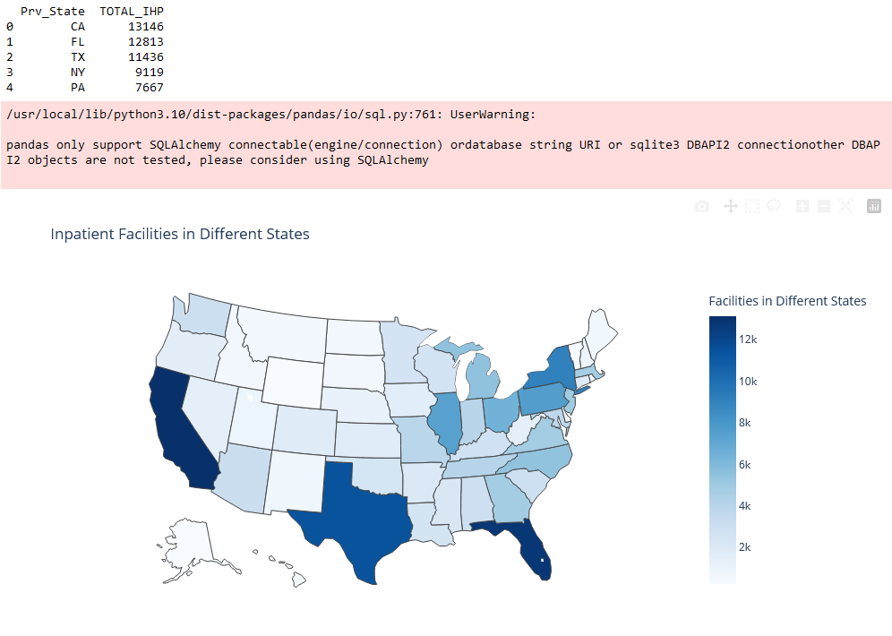
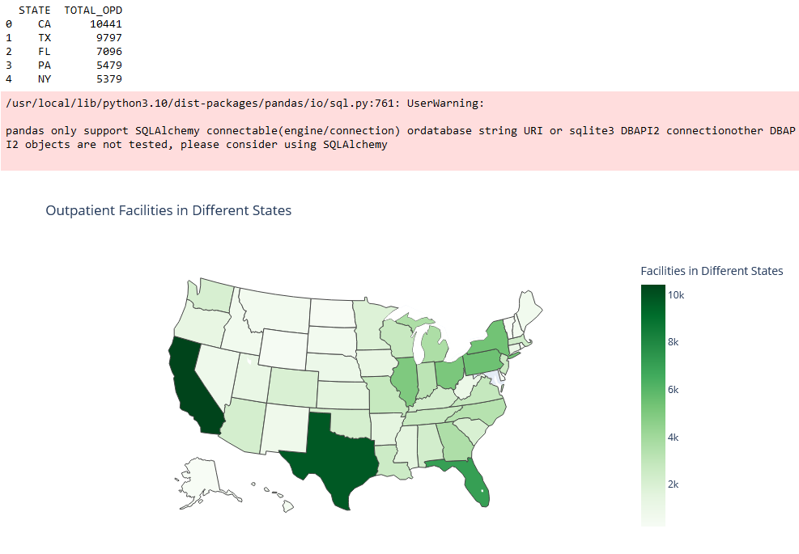
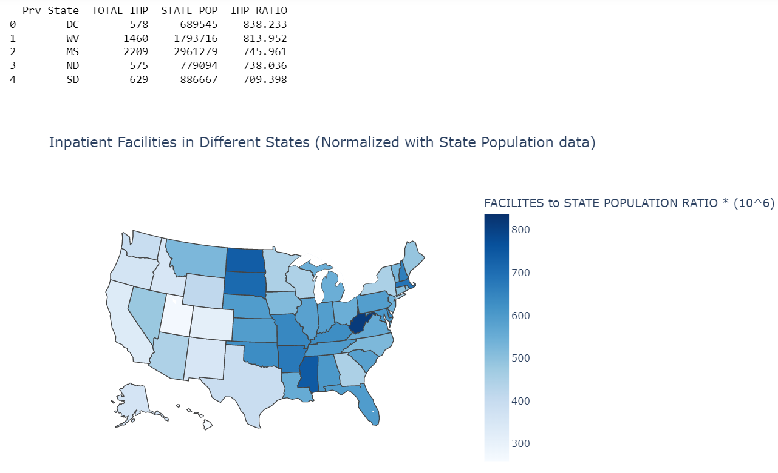
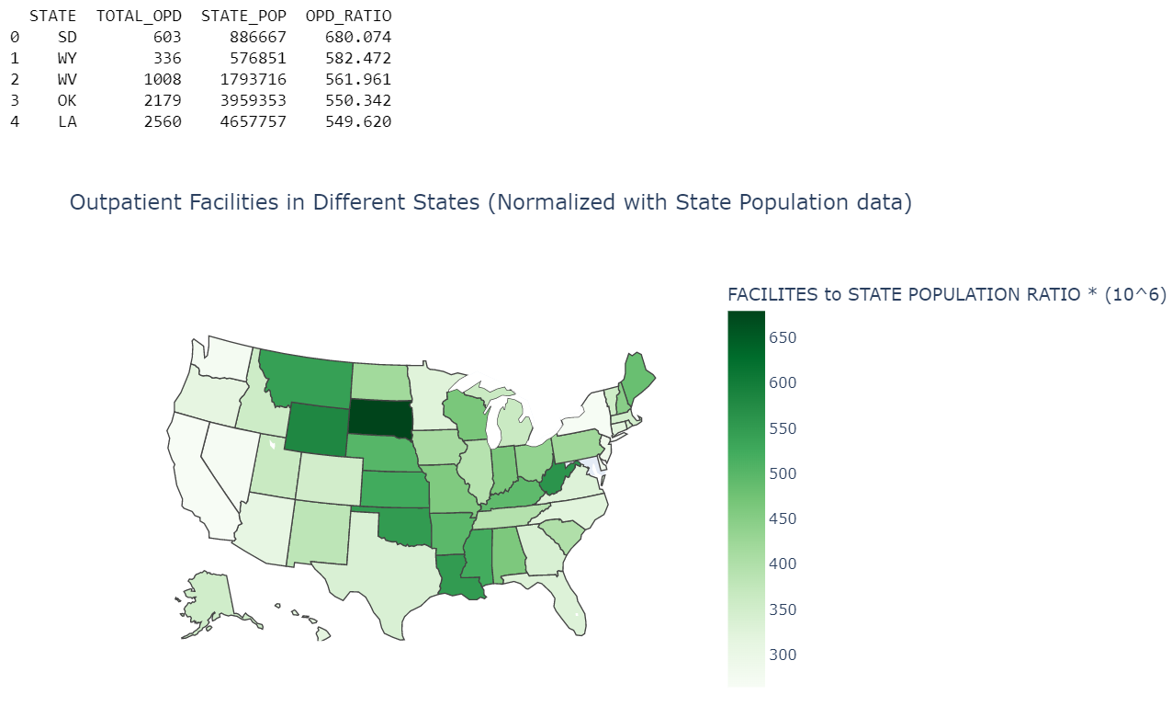
DISTRIBUTION OF FACILITIES IN DIFFERENT STATES AND INDIANA CITIES
INPATIENT & OUTPATIENT FACILITIES
States with the Largest Populations (Example: California, Texas) do not proportionately have the highest number of available facilities.
There are higher number of facilities towards the Eastern side of the US.

Slide 22
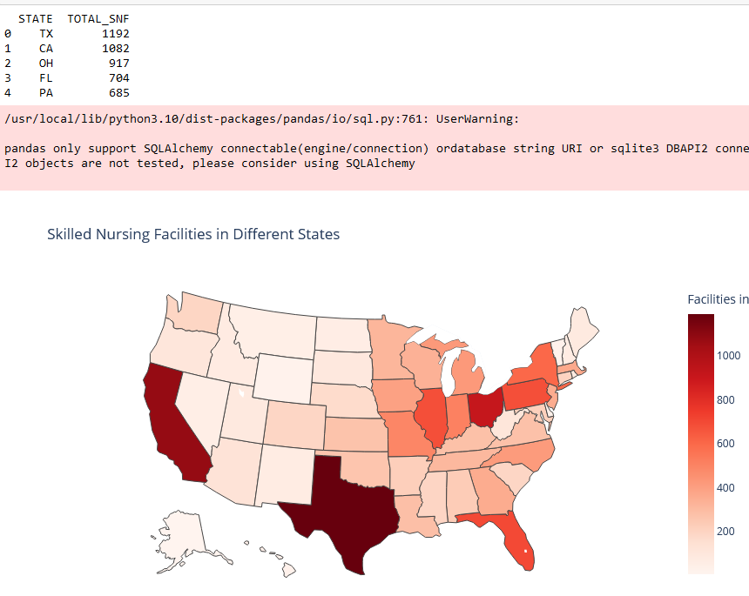
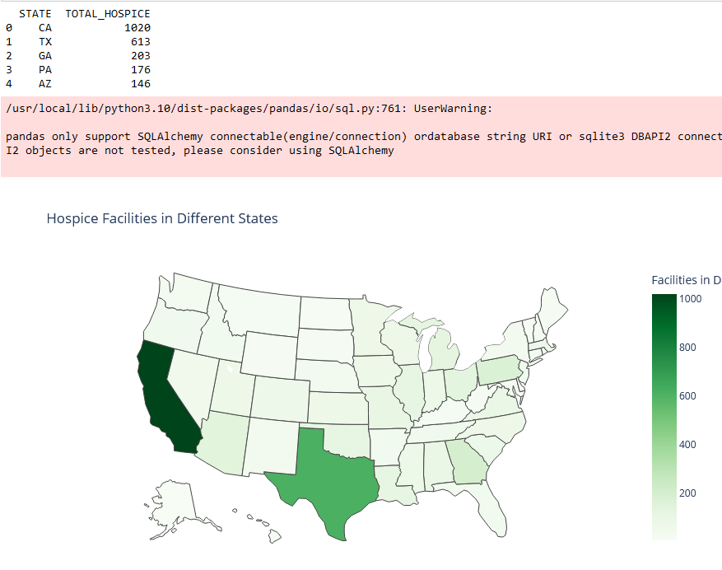
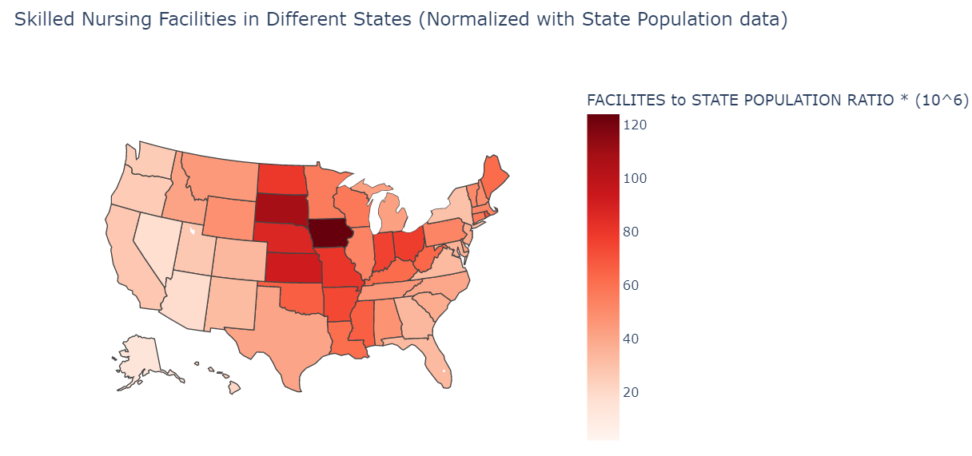
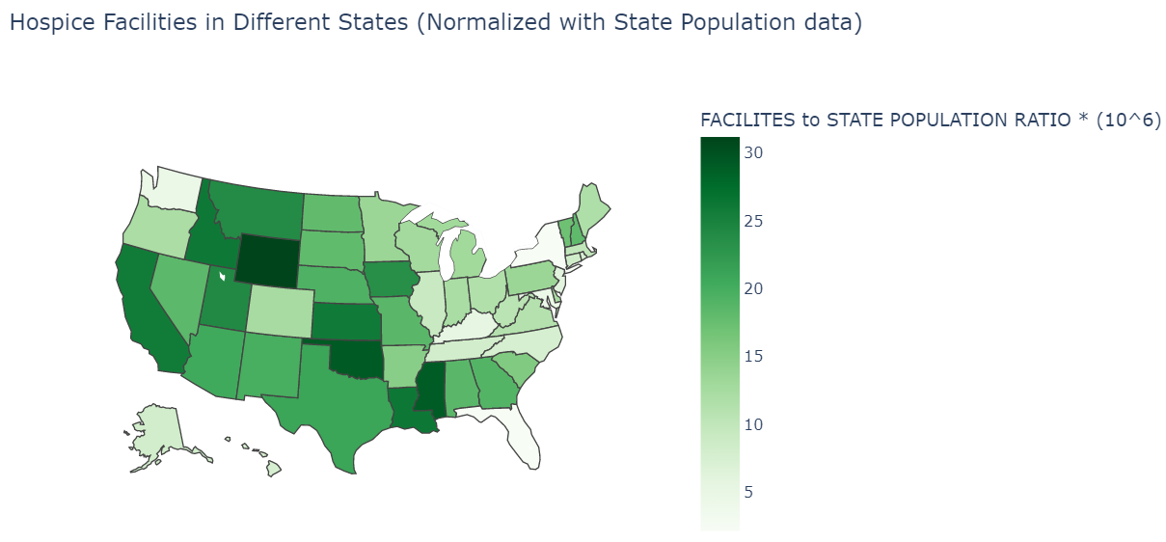
DISTRIBUTION OF FACILITIES IN DIFFERENT STATES AND INDIANA CITIES
SNF & HOSPICE FACILITIES
SNFs are more heavily distributed in the Eastern regions while more Hospices are present in the Western States

Slide 23
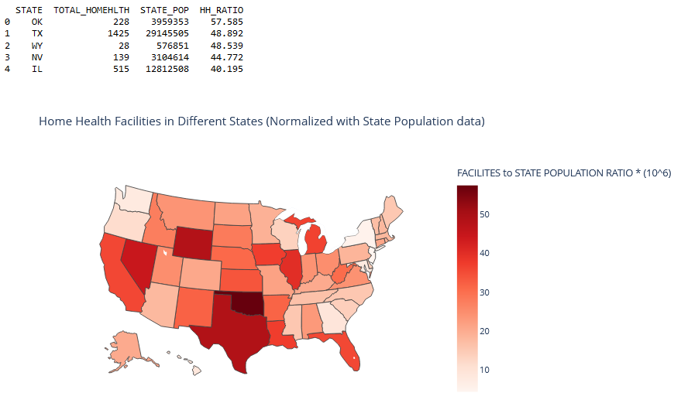
DISTRIBUTION OF FACILITIES IN DIFFERENT STATES AND INDIANA CITIES
HOME HEALTH FACILITIES
Except for the northwest states of Oregon, Washington, and the northeastern parts, almost all states have a similar distribution of Home health facilities

Slide 24
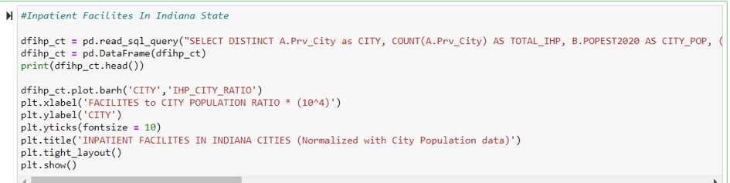
DISTRIBUTION OF FACILITIES IN INDIANA CITIES
Code for Inpatient Facilities
IRFs and LTCs seem to have a similar distribution pattern across the States
Additional codes in Appendix

Slide 25
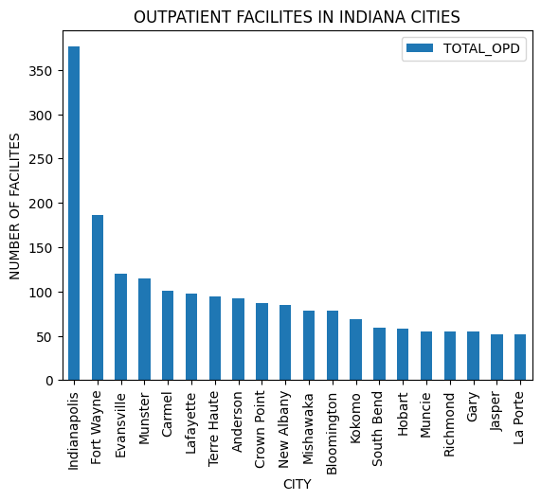
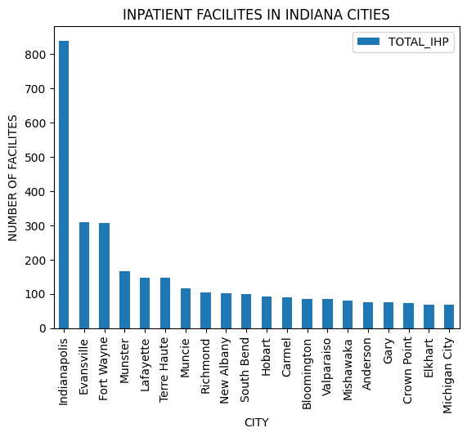
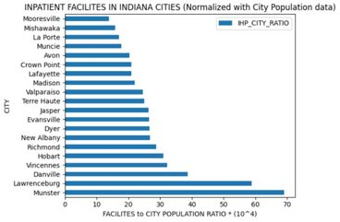
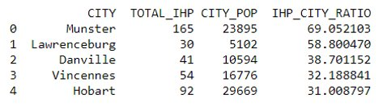
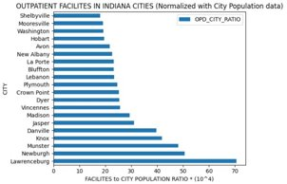
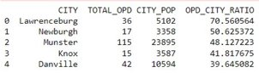
DISTRIBUTION OF FACILITIES IN INDIANA CITIES INPATIENT & OUTPATIENT FACILITIES
Even at the city level, the largest population centers do not have proportional higher number of facilities

Slide 26
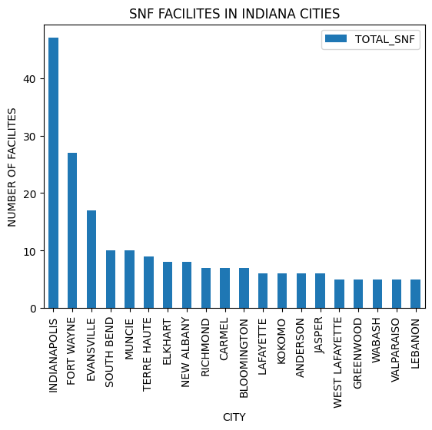
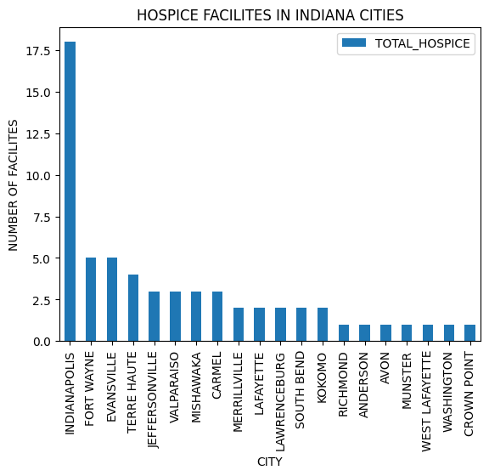
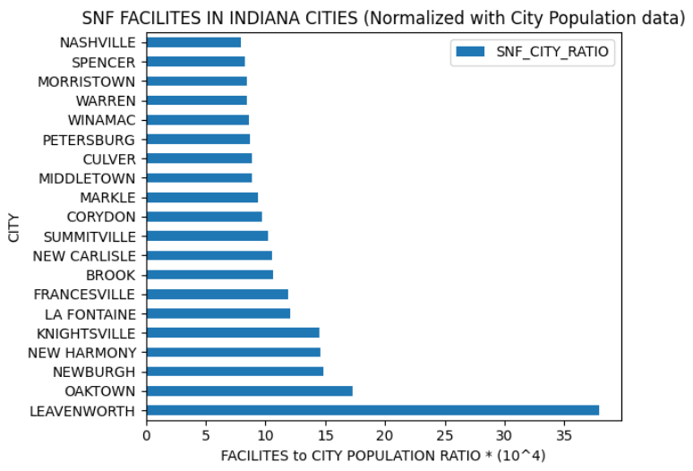
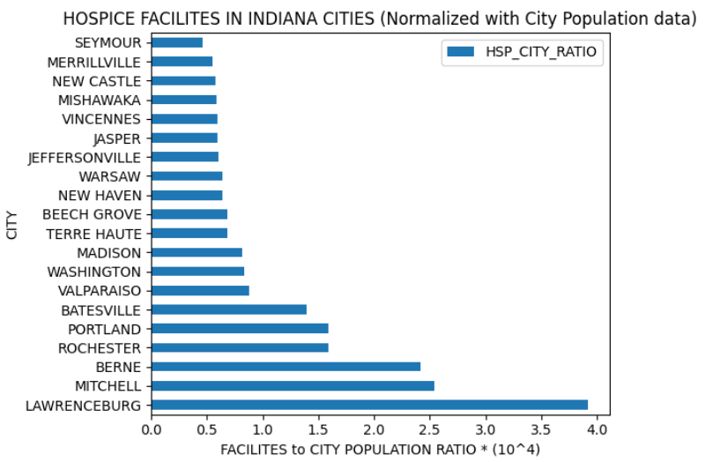
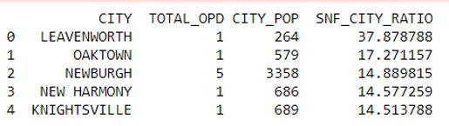
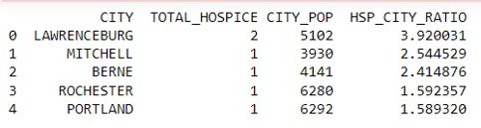
DISTRIBUTION OF FACILITIES IN INDIANA CITIES SNF & HOSPICE FACILITIES
Even at the city level, the largest population centers do not have proportional higher number of facilities.

Slide 27
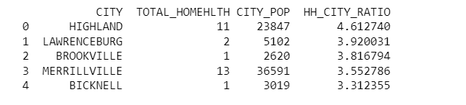
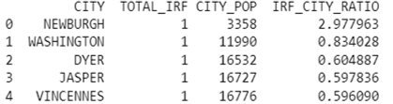
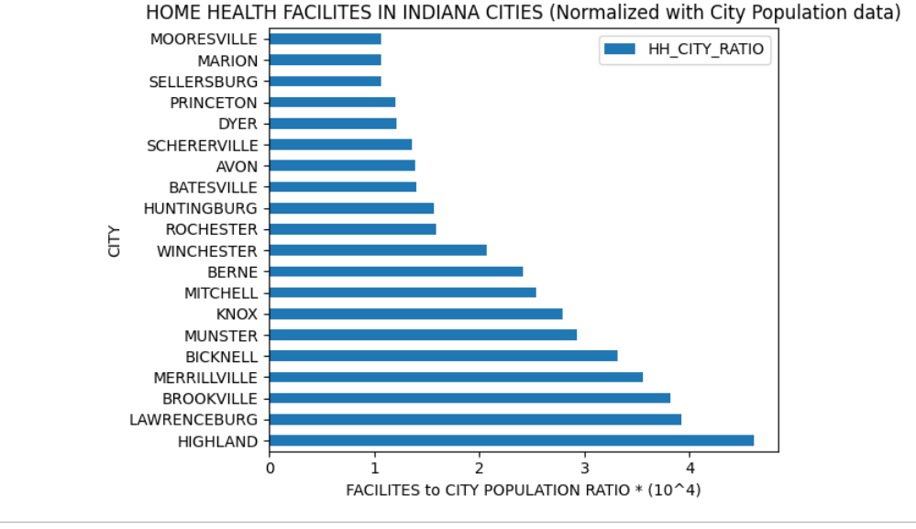
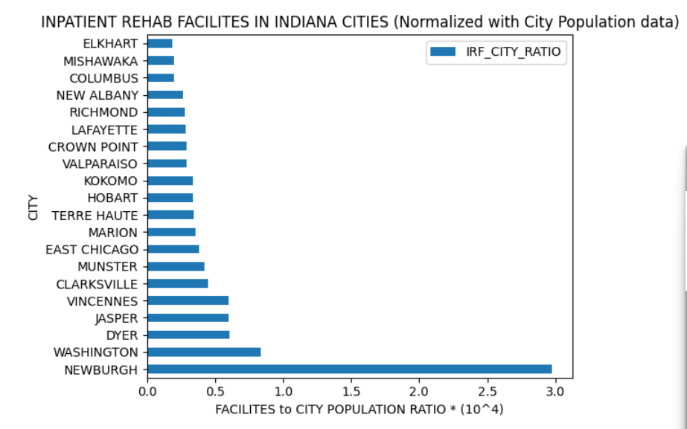
DISTRIBUTION OF FACILITIES IN INDIANA CITIES HOME HEALTH & IRF FACILITIES
There are a limited number of facilities in most Indiana cities, regardless of the population of the city

Slide 28
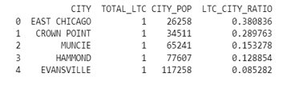
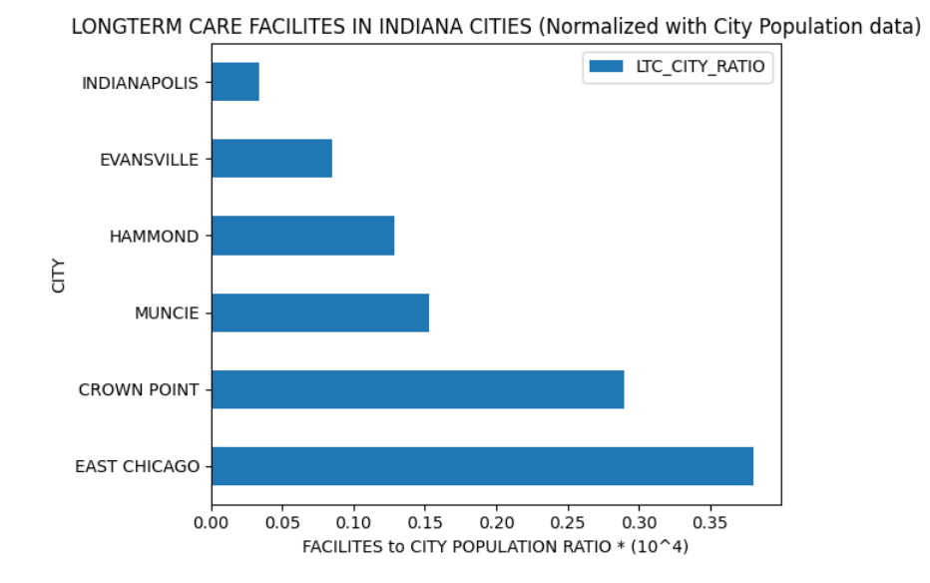
DISTRIBUTION OF FACILITIES IN INDIANA CITIES LONG TERM CARE FACILITIES
There are only 5 Long term care facilities in all of Indiana

Slide 29
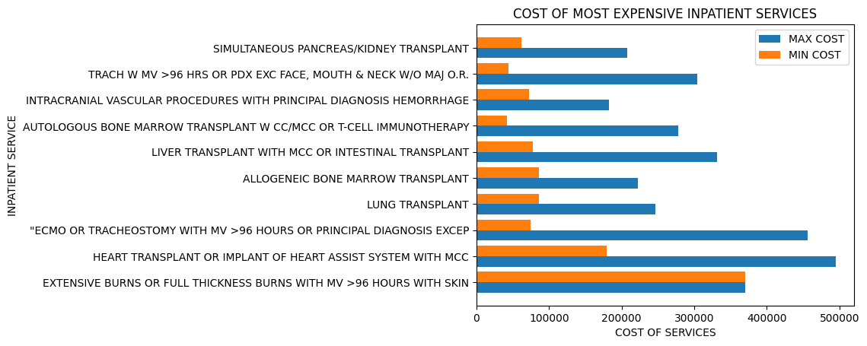
MOST EXPENSIVE INPATIENT SERVICES
Code In Appendix
Transplants are some of the most expensive inpatient services available

Slide 30
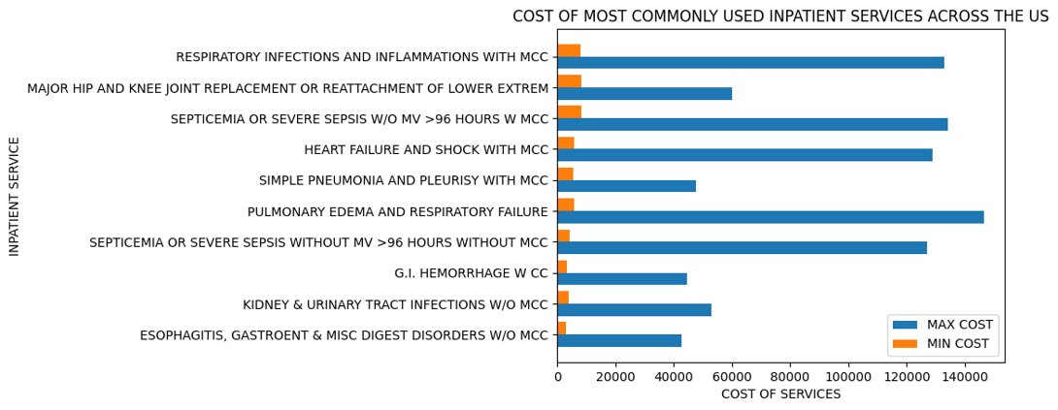
COMPARATIVE COST OF MOST COMMONLY USED INPATIENT SERVICES IN THE US
Code In Appendix
There is a major difference in the cost of the same services when offered by different providers

Slide 31
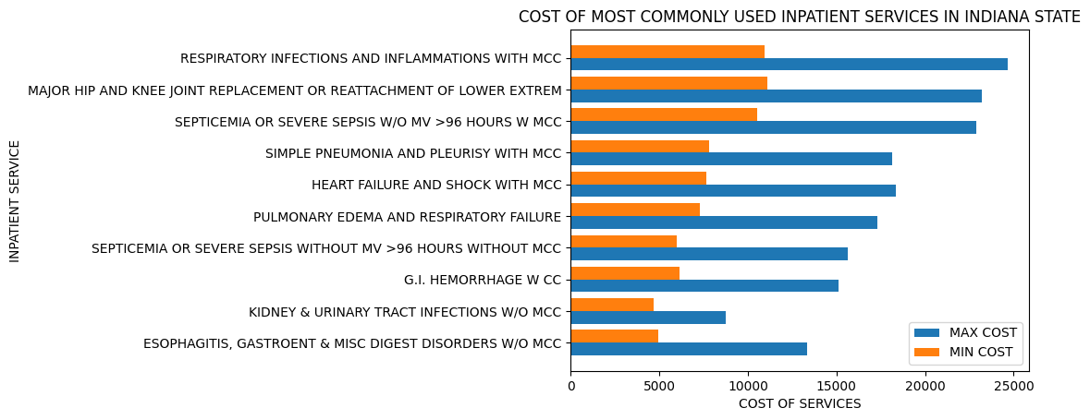
COMPARATIVE COST OF MOST COMMONLY USED INPATIENT SERVICES IN INDIANA
Code In Appendix
There is a major difference in the cost of the same services when offered by different providers

Slide 32
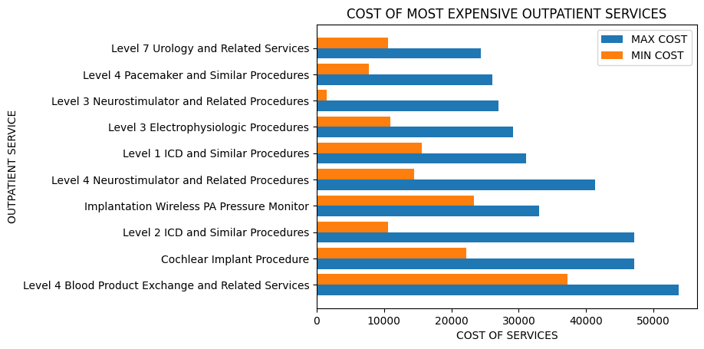
MOST EXPENSIVE OUTPATIENT SERVICES
Code In Appendix
Cochlear Implants and Blood product exchanges are some of the most expensive outpatient services availed by patients

Slide 33
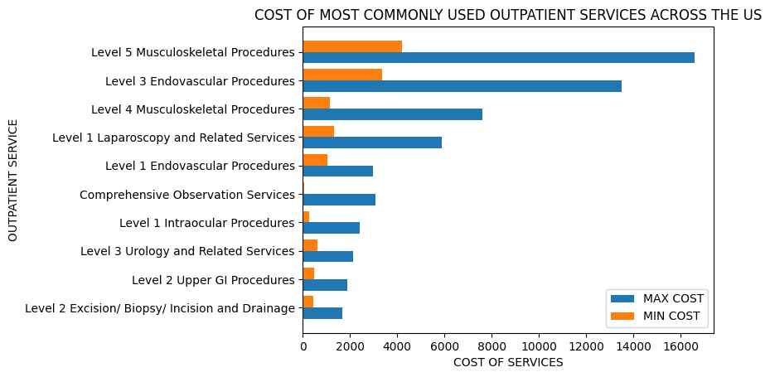
COMPARATIVE COST OF MOST COMMONLY USED OUTPATIENT SERVICES IN INDIANA
There is a major difference in the cost of the same services when offered by different providers

Slide 34
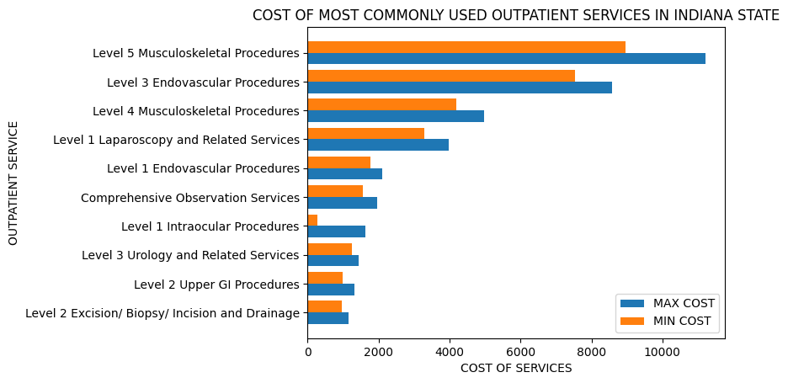
COMPARATIVE COST OF MOST COMMONLY USED OUTPATIENT SERVICES IN INDIANA
There is a major difference in the cost of the same services when offered by different providers

Slide 35
Top Indications Based on Patient counts for Inpatient and Outpatient Services

Slide 36
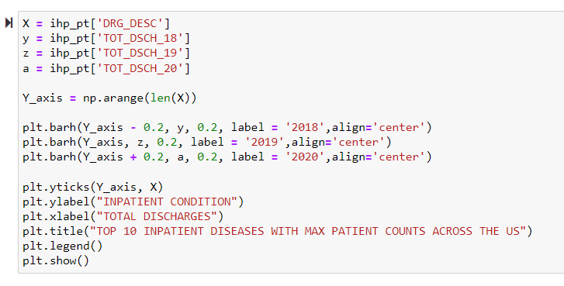
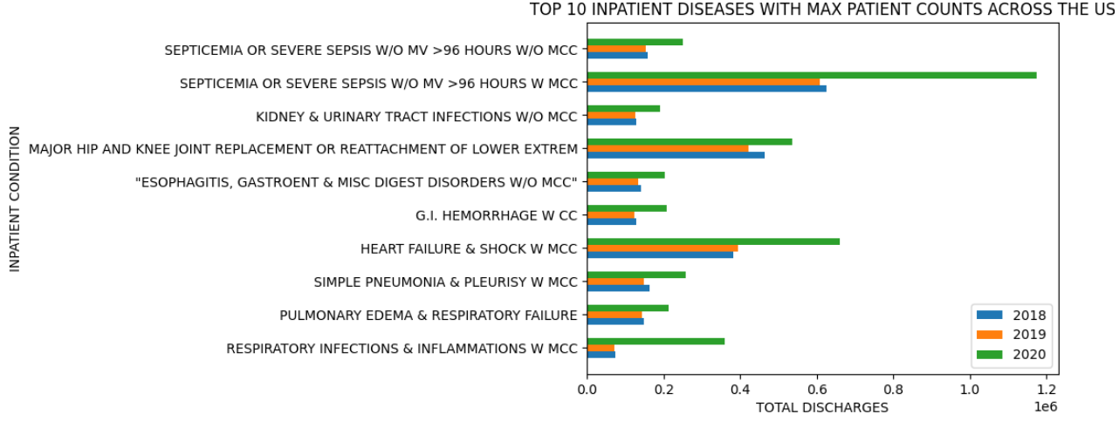
Top 10 Inpatient diseases with max patient counts across the US
Sepsis, hip and knee replacement, and heart failure are the most common diseases that we can see through the plot below and their occurrence increased in the year 2020 when compared before pandemic. The rise in inpatient stays after the pandemic indicates that almost all diseases and comorbidities have increased.

Slide 37
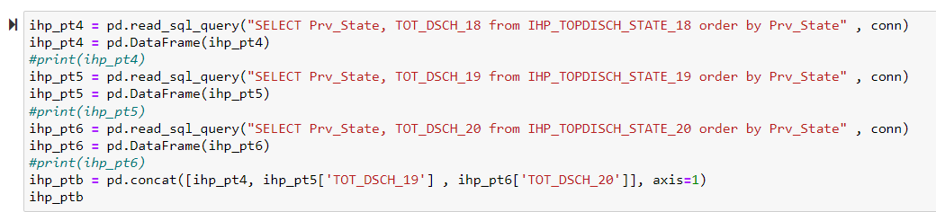
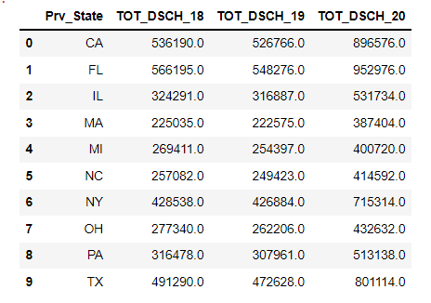
Top 10 States with Max Inpatient cases across the US
California and Florida are among the highest states to access inpatient services across the US with a major increase in usage during the pandemic

Slide 38
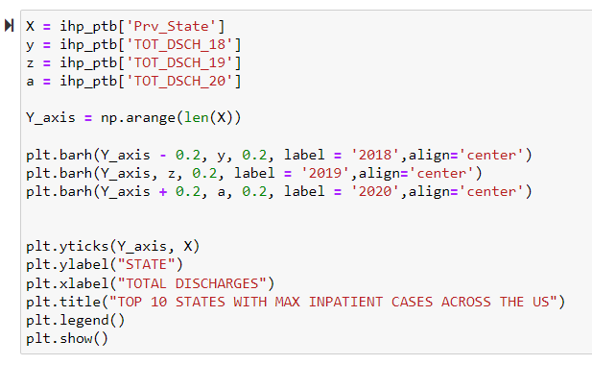
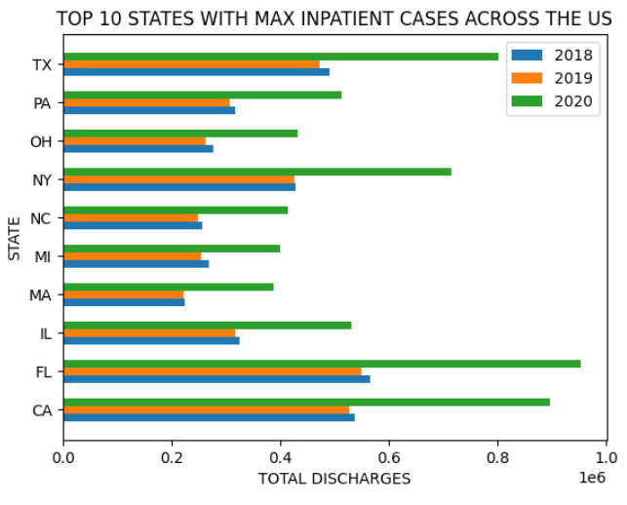
Top 10 States with Max Inpatient cases across the US
The most inpatients cases are reported in the state Florida in three years. Across all the states there are a greater number of patients admitted in the year 2020 when compared to previous years i.e before pandemic. This proves that COVID pandemic has caused severe damage to human health as they increased the comorbidities.

Slide 39
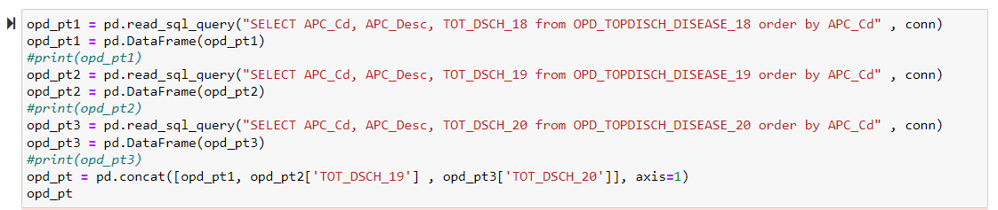
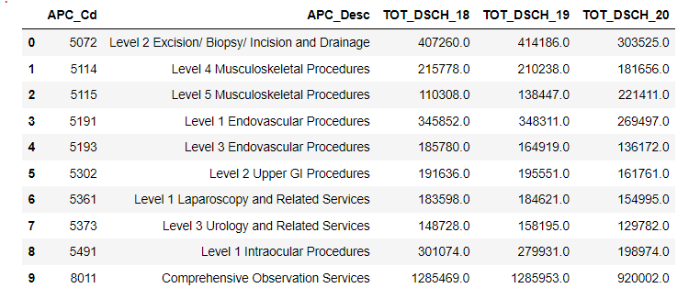
Top 10 Outpatient Diseases with Max Patient Counts Across the US
There was a drop in usage of outpatient services during the pandemic as compared to in previous years

Slide 40


Top 10 Outpatient Diseases with Max Patient Counts Across the US
Level 2 excision\ biopsy or incision and drainage is noted as the severe condition for which many patients used outpatient services. This plot also explains that the infections in the blood increased in the patients after the pandemic as their body is easily prone to diseases when compared to 2018 and 2019.

Slide 41


Top 10 states with Max Outpatient across the US
The most outpatient cases are reported in the state of Texas in the year 2019. Across all the states there are a greater number of patients admitted in the year 2019.​

Slide 42

Percent of male and female patients in 2020 Hospices at the top 20 cities across the US
Even when comparing the top 20 cities of the US percentage of females in Hospice services is more when compared to male patients.

Slide 43

Percent of male and female patients in 2020 SNFs at different states
This diagram illustrates that female beneficiaries claim more Medicare facilities across all states In the country when compared to male beneficiaries.

Slide 44

Percent of male and female patients in 2020 SNFs at top 20 cities across the us
Apart from Chicago, Los Angeles, and the Bronx, all 20 of the largest US cities have more female patients than male patients in skilled nursing facilities.

Slide 45

Percent of male and female patients at Hospices in 2020 states across the us
Except for Wyoming, where male and female patients are equally beneficial, the percentage of female patients in hospices is higher across all states in the United States in 2020.

Slide 46

Distribution of Male and Female Beneficiaries across States and in Indiana

Slide 47

Access to SNF level Care by Ethnicity at national levels​
This graph depicts the ethnic gap in skilled nursing facilities provided by Medicare at the national level, and it is clear that white people in the country receive 81% more benefits than any other group but African Americans and Hispanics also benefit with 11.3% and 5.2%, respectively, while the other groups are 1% and less than 1%. This shows that there is a disparity in providing the availability of services and claims because there is a huge difference in services when compared to others.

Slide 48


Access to SNF level Care by Ethnicity in Indiana state ​
Even in the state of Indiana, whites have more SNF facilities (92.8%), with African Americans accounting for 6.2% and the rest of the groups accounting for the remaining 1%.

Slide 49

Access to Hospice care by Ethnicity at National Level
The Pie chart shows that White people used Hospice care the most, with 82.5%, while African Americans and Hispanics share an equal percentage, with a one percent difference of 8.2 and 7.2%, respectively, and the other population shares the remaining 3%.

Slide 50


Access to Hospice care by Ethnicity in Indiana State
From the pie chart, we can see that White are the people who used hospice care most with almost 94% whereas African Americans takes 5% and the rest of the other categories take the rest less than 1%

Slide 51
Clustering SNF Facilities by Stay Details, Medicare charges, Distribution of patients by Gender, Ethnicity, Chronic Conditions

Slide 52


SNF Clustering with BIRCH

Slide 53



SNF Clustering with BIRCH
Best Silhouette score obtained for n=2 clusters
We will proceed with this for Clustering

Slide 54


Dimension Reduction with Principal Component Analysis (PCA)
At least 17 components are required to account for a variation of greater than 90% for the SNF data

Slide 55


Visualizing SNF Clusters using Top 2 PCA components
Two clear clusters of SNF facilities can be observed in the data

Slide 56


Visualizing SNF Clusters using Top 2 PCA components
Two clear clusters of SNF facilities can be observed in the data

Slide 57




Clustering Hospice Facilites
Birch Clustering
PCA Visualization​
At least 17 components are required to account for a variation of greater than 90% for the Hospice data
Only one clear cluster is visible for the Hospice facilities. Very few data points are present in the 2nd cluster
Best Silhouette score obtained for n=2 clusters
We will proceed with this for Clustering

Slide 58


Clustering Hospice Facilites
PCA Visualization​
Best Silhouette score obtained for n=2 clusters
We will proceed with this for Clustering
At least 17 components are required to account for a variation of greater than 90% for the Hospice data
Only one clear cluster is visible for the Hospice facilities. Very few data points are present in the 2nd cluster

Slide 59




Clustering Home Health Facilites
Birch Clustering
PCA Visualization​
At least 16 components are required to account for a variation of greater than 90% for the Home Health data
Two distinct clusters can be seen in the data
Best Silhouette score obtained for n=2 clusters
We will proceed with this for Clustering

Slide 60


Clustering Home Health Facilites
Birch Clustering
PCA Visualization​
At least 16 components are required to account for a variation of greater than 90% for the Home Health data
Two distinct clusters can be seen in the data
Best Silhouette score obtained for n=2 clusters
We will proceed with this for Clustering

Slide 61




Clustering IRF Facilites
Birch Clustering
PCA Visualization​
At least 17 components are required to account for a variation of greater than 90% for the IRF data
Two distinct clusters can be seen in the data
Best Silhouette score obtained for n=2 clusters
We will proceed with this for Clustering

Slide 62


Clustering IRF Facilites
Birch Clustering
PCA Visualization​
At least 17 components are required to account for a variation of greater than 90% for the IRF data
Two distinct clusters can be seen in the data
Best Silhouette score obtained for n=2 clusters
We will proceed with this for Clustering

Slide 63




Clustering LTC Facilites
Birch Clustering
PCA Visualization​
At least 15 components are required to account for a variation of greater than 90% for the LTC data
Only one clear cluster is visible for the Hospice facilities. Very few data points are present in the 2nd cluster
Best Silhouette score obtained for n=2 clusters
We will proceed with this for Clustering

Slide 64


Clustering LTC Facilites
Birch Clustering
PCA Visualization​
At least 15 components are required to account for a variation of greater than 90% for the LTC data
Only one clear cluster is visible for the Hospice facilities. Very few data points are present in the 2nd cluster
Best Silhouette score obtained for n=2 clusters
We will proceed with this for Clustering

Slide 65
Conclusion
Exploratory data analysis yielded the following results:
Contrary to expectation, places with the highest population numbers while having a higher number of facilities, do not have the required numbers to provide the same level of access that is available in lesser populated areas.
There is a big difference in the cost of services offered to patients by facilities located in different areas providing the same services. This difference can also be seen in the most commonly performed inpatient and outpatient procedures.
Post acute and Hospice care are more accessible or used by female patients and white patients than any other demographic.
White patients account for more than 80% of the Post acute care and Hospice facility usage in the US (Alternate Hypothesis is true).
Clustering analysis was performed for Post acute care and Hospice services only as the demographic data was not available for inpatient and outpatient services. The results showed that:
In case of the more commonly used services such as SNFs, IRFs and Home Health services, there is a definite difference in the patient demographics, services utilized and cost associated with care (Alternate Hypothesis is true).
2 groups of facilities can be observed with some common features in the case of SNFs, IRFs and Home Health services and there are at least 15-17 factors that include a mix of cost of services, patient stay details, population demographics and breadth of services offered for different chronic conditions that influence the level of care available through these facilities.
Since Hospice care and Long term care facilities provide a very defined set of services and are generally fewer in number, There isn’t a significant difference in the services available through them and in the patient demographics which is why almost all of the providers can be grouped into a single cluster (Null Hypothesis is true in this case).
Best Silhouette score obtained for n=2 clusters
We will proceed with this for Clustering

Slide 66
REFERENCES
Mues, K. E., Liede, A., Liu, J., Wetmore, J. B., Zaha, R., Bradbury, B. D., Collins, A. J., & Gilbertson, D. T. (2017). Use of the Medicare database in epidemiologic and health services research: a valuable source of real-world evidence on the older and disabled populations in the US. Clinical epidemiology, 9, 267–277 Reference Link
https://www.investopedia.com/terms/s/skilled-nursing-facility.asp#:~:text=A%20skilled%20nursing%20facility%20is%20an%20in-patient%20rehabilitation,physical%20and%20occupational%20therapists%2C%20speech%20pathologists%2C%20and%20audiologists.
https://www.medicare.gov/what-medicare-covers/whats-home-health-care#:~:text=Home%20health%20care%20is%20a,skilled%20nursing%20facility%20(SNF).
https://www.nia.nih.gov/health/what-are-palliative-care-and-hospice-care#hospice
https://www.bacharach.org/what-is-an-irf/
https://www.cdc.gov/longtermcare/index.html

Slide 67
APPENDIX OF CODES
TABLE CREATION IN PYTHON
TABLES DIRECTLY LOADED INTO MARIADB
TABLE CREATION IN MARIADB
DISTRIBUTION OF FACILITIES IN DIFFERENT STATES AND INDIANA CITIES
TOP INDICATIONS BASED ON PATIENT COUNTS FOR INPATIENT AND OUTPATIENT SERVICES
MOST EXPENSIVE INPATIENT AND OUTPATIENT CONDITIONS BY COST
ACCESS TO CARE BY ETHNICITY AT NATIONAL AND STATE LEVELS
RUCA LEVEL DISTRIBUTION OF FACILITIES

Slide 68
APPENDIX OF CODES AFTER CLUSTERING
CLUSTERING SNF FACILITES BY STAY DETAILS, MEDICARE CHARGES, DISTRIBUTION OF PATIENTS BY GENDER, ETHNICITY, CHRONIC CONDITIONS
ACCESS TO SNF LEVEL CARE BY ETHNICITY IN INDIANA STATE
CLUSTERING HOME HEALTH FACILITES BY STAY DETAILS, MEDICARE CHARGES, DISTRIBUTION OF PATIENTS BY GENDER, ETHNICITY, CHRONIC
CLUSTERING HOSPICE FACILITES BY STAY DETAILS, MEDICARE CHARGES, DISTRIBUTION OF PATIENTS BY GENDER, ETHNICITY, CHRONIC CONDITIONS
CLUSTERING FOR INPATIENT REHAB FACILITIES IS DONE AMONG MEDICARE CHARGES, GENDER DISTRIBUTION, ETHNICITY AND SOME CHRONIC CONDITION.
CLUSTERING INPATIENT REHAB FACILITES BY STAY DETAILS, MEDICARE CHARGES, DISTRIBUTION OF PATIENTS BY GENDER, ETHNICITY, CHRONIC CONDITIONS
CLUSTERING HOME HEALTH FACILITES BY STAY DETAILS, MEDICARE CHARGES, DISTRIBUTION OF PATIENTS BY GENDER, ETHNICITY, CHRONIC CONDITIONS
CLUSTERING LONGTERM CARE FACILITES BY STAY DETAILS, MEDICARE CHARGES, DISTRIBUTION OF PATIENTS BY GENDER, ETHNICITY, CHRONIC CONDITIONS

Slide 69

TABLE CREATION IN PYTHON

Slide 70

TABLE CREATION IN PYTHON

Slide 71
TABLE CREATION IN PYTHON

Slide 72

TABLE CREATION IN PYTHON

Slide 73

TABLE CREATION IN PYTHON

Slide 74
TABLE CREATION IN PYTHON

Slide 75
TABLE CREATION IN MARIADB
CREATE TABLE IHP_TOPDISCH_DISEASE_19 AS
(SELECT B.DRG_CD, B.DRG_DESC, SUM(B.TOT_DSCHRGS) AS TOT_DSCH_19
FROM Inpatient_2019_PrvSrv B
WHERE B.DRG_CD IN (871,291,470,177,193,872,189,378,392,690)
GROUP BY B.DRG_CD, B.DRG_DESC
ORDER BY SUM(B.TOT_DSCHRGS) DESC);
CREATE TABLE IHP_TOPDISCH_DISEASE_20 AS
(SELECT C.DRG_CD, C.DRG_DESC, SUM(C.TOT_DSCHRGS) AS TOT_DSCH_20
FROM Inpatient_2020_PrvSrv C
WHERE C.DRG_CD IN (871,291,470,177,193,872,189,378,392,690)
GROUP BY C.DRG_CD, C.DRG_DESC
ORDER BY SUM(C.TOT_DSCHRGS) DESC);
CREATE TABLE IHP_TOPDISCH_STATE_19 AS
(SELECT B.Prv_State, SUM(B.TOT_DSCHRGS) AS TOT_DSCH_19
FROM Inpatient_2019_PrvSrv B
WHERE B.Prv_State IN ('FL','CA','TX','NY','IL','PA','OH','NC','MI','MA')
GROUP BY B.Prv_State
ORDER BY SUM(B.TOT_DSCHRGS) DESC);
Additional Table scripts in Appendix

Slide 76
TABLE CREATION IN MARIADB
CREATE TABLE IHP_TOPDISCH_DISEASE_19 AS
(SELECT B.DRG_CD, B.DRG_DESC, SUM(B.TOT_DSCHRGS) AS TOT_DSCH_19
FROM Inpatient_2019_PrvSrv B
WHERE B.DRG_CD IN (871,291,470,177,193,872,189,378,392,690)
GROUP BY B.DRG_CD, B.DRG_DESC
ORDER BY SUM(B.TOT_DSCHRGS) DESC);
CREATE TABLE IHP_TOPDISCH_DISEASE_20 AS
(SELECT C.DRG_CD, C.DRG_DESC, SUM(C.TOT_DSCHRGS) AS TOT_DSCH_20
FROM Inpatient_2020_PrvSrv C
WHERE C.DRG_CD IN (871,291,470,177,193,872,189,378,392,690)
GROUP BY C.DRG_CD, C.DRG_DESC
ORDER BY SUM(C.TOT_DSCHRGS) DESC);
CREATE TABLE IHP_TOPDISCH_STATE_19 AS
(SELECT B.Prv_State, SUM(B.TOT_DSCHRGS) AS TOT_DSCH_19
FROM Inpatient_2019_PrvSrv B
WHERE B.Prv_State IN ('FL','CA','TX','NY','IL','PA','OH','NC','MI','MA')
GROUP BY B.Prv_State
ORDER BY SUM(B.TOT_DSCHRGS) DESC);
Additional Table scripts in Appendix

Slide 77
TABLE CREATION IN MARIADB
CREATE TABLE OPD_TOPDISCH_STATE_19 AS SELECT B.Prv_State, SUM(B.Bene_Cnt) AS TOT_DSCH_19 FROM Outpatient_2019_PrvSrv B WHERE B.Prv_State IN ('CA','TX','FL','NY','IL','OH','PA','NC','MI','VA') GROUP BY B.Prv_State ORDER BY SUM(B.Bene_Cnt) DESC
CREATE TABLE OPD_TOPDISCH_STATE_20 AS SELECT C.Prv_State, SUM(C.Bene_Cnt) AS TOT_DSCH_20 FROM Outpatient_2020_PrvSrv C WHERE C.Prv_State IN ('CA','TX','FL','NY','IL','OH','PA','NC','MI','VA') GROUP BY C.Prv_State ORDER BY SUM(C.Bene_Cnt) DESC
Additional Table scripts in Appendix

Slide 78
TABLE CREATION IN MARIADB
CREATE TABLE IHP_TOPDISCH_STATE_20 AS
(SELECT C.Prv_State, SUM(C.TOT_DSCHRGS) AS TOT_DSCH_20
FROM Inpatient_2020_PrvSrv C
WHERE C.Prv_State IN ('FL','CA','TX','NY','IL','PA','OH','NC','MI','MA')
GROUP BY C.Prv_State
ORDER BY SUM(C.TOT_DSCHRGS) DESC);
CREATE TABLE OPD_TOPDISCH_DISEASE_19 AS
SELECT B.APC_Cd, B.APC_Desc, SUM(B.Bene_Cnt) AS TOT_DSCH_19
FROM Outpatient_2019_PrvSrv B
WHERE B.APC_Cd IN (8011,5072,5191,5115,5491,5114,5302,5361,5193,5373)
GROUP BY B.APC_Cd, B.APC_Desc
ORDER BY SUM(B.Bene_Cnt) DESC
CREATE TABLE OPD_TOPDISCH_DISEASE_20 AS
SELECT C.APC_Cd, C.APC_Desc, SUM(C.Bene_Cnt) AS TOT_DSCH_20
FROM Outpatient_2020_PrvSrv C
WHERE C.APC_Cd IN (8011,5072,5191,5115,5491,5114,5302,5361,5193,5373)
GROUP BY C.APC_Cd, C.APC_Desc
ORDER BY SUM(C.Bene_Cnt) DESC
Additional Table scripts in Appendix

Slide 79

Inpatient Facilities by State
Additional Table scripts in Appendix

Slide 80

Outpatient Facilities by State

Slide 81

SNF Facilities by State

Slide 82

Hospice Facilities by State

Slide 83

Home Health Facilities by State

Slide 84

Inpatient Rehab Facilities by State

Slide 85

Long-term Care Facilities by State

Slide 86

Inpatient Facilities In Indiana State

Slide 87

Outpatient Facilities In Indiana State

Slide 88

SNF Facilities In Indiana State

Slide 89

Hospice Facilities In Indiana State

Slide 90

Home Health Facilities In Indiana State

Slide 91

IRF Facilities In Indiana State

Slide 92

Long-Term Facilities In Indiana State

Slide 93

Top Indications Based on Patient counts for Inpatient and Outpatient Services
Additional Table scripts in Appendix

Slide 94
Top 10 Inpatient diseases with max patient counts across the US

Slide 95
Top 10 States with Max Inpatient cases across the US

Slide 96
Top 10 States with Max Inpatient cases across the US

Slide 97
Top 10 Outpatient Diseases with Max Patient Counts Across the US

Slide 98
Top 10 Outpatient Diseases with Max Patient Counts Across the US

Slide 99


Top 10 states with Max Outpatient across the US

Slide 100
Top 10 states with Max Outpatient across the US

Slide 101


Maximum and Minimum HCC scores by state for Hospices​
The following codes are used to visualize the maximum and minimum HCC scores by state for Hospice and the plots bar charts are displayed in the next slide.

Slide 102


Maximum and Minimum HCC scores for Indiana SNFs in different cities

Slide 103


Maximum and Minimum HCC scores for Indiana Hospices facilities in different cities

Slide 104
Distribution of Male and Female Beneficiaries across States and in Indiana

Slide 105

Percent of male and female patients in 2020 SNFs at top 20 cities across the US

Slide 106

Percent of male and female patients at Hospices in 2020 states across the US

Slide 107

Percent of male and female patients in 2020 Hospices at the top 20 cities across the US

Slide 108

Access to SNF level Care by Ethnicity in Indiana state

Slide 109

Clustering Home Health Facilites by Stay Details, Medicare charges, Distribution of patients by Gender, Ethnicity, Chronic

Slide 110


Slide 111

Clustering Hospice Facilites by Stay Details, Medicare charges, Distribution of patients by Gender, Ethnicity, Chronic Conditions

Slide 112


Slide 113

Clustering SNF Facilities by Stay Details, Medicare charges, Distribution of patients by Gender, Ethnicity, Chronic Conditions

Slide 114


Slide 115

Clustering for Inpatient Rehab facilities is done among Medicare charges, gender distribution, ethnicity and some chronic condition.

Slide 116

Clustering Long-term care facilities by Stay Details, Medicare charges, Distribution of Patients by gender, Ethnicity, chronic conditions .

Slide 117
THANK YOU

